Slide 1
Visualizing Collections Of Internet Archives
John Berlin, Joel Rodriguez, Slobodan Milanko

Slide 2


Motivation
Current solutions are limiting; small focus
Archivers are unable to visually experience
their collections
Lack of URI evolution
Lack of comparison
User driven, clutter free, design for moderate collections
Archivers desire to visually share collections with each other.

Slide 3
Dataset Description
We're abstracting the user's archive collection as a table.
Categorical key attribute that maps to categorical or
quantitative values.
Archiver - Categorical
Tags - Categorical
Number of archives - Quantitative
The table approach:
Facilitates ordering
Filtering of data.

Slide 4
Abstract Tasks
Lookup, browse, explore and locate can be achieved easily
with the table abstraction.
Users will be able to identify and compare
different archive records

Slide 5

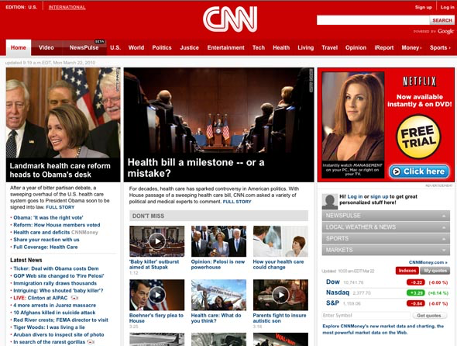

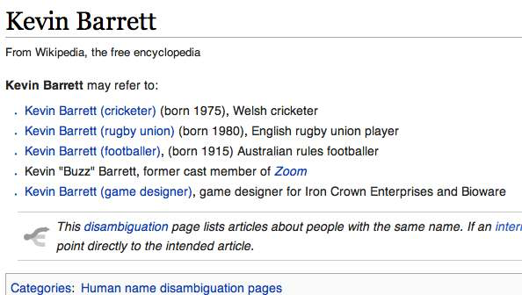
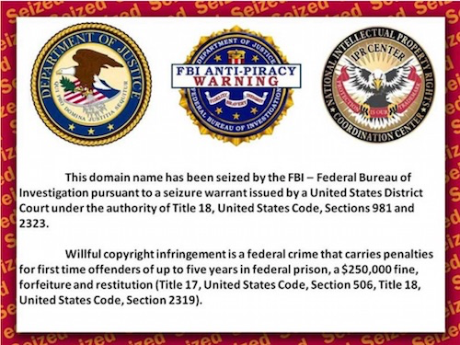
Potential Design

Slide 6
User Driven Control
FILTER
Selection
Group
Criteria
Filter and drill
down by desired
precision
CATEGORY
Date
Tags
URI-M

Slide 7
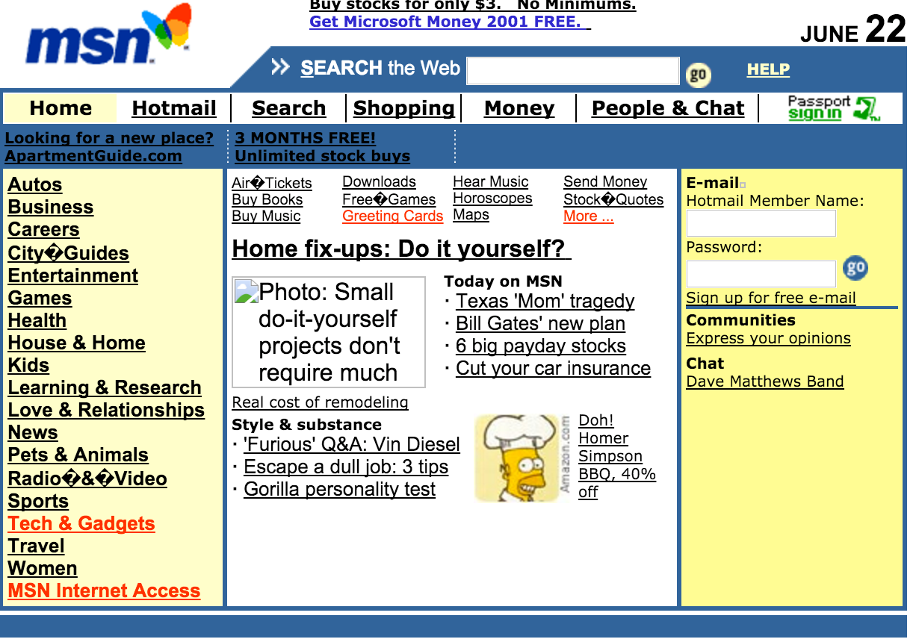


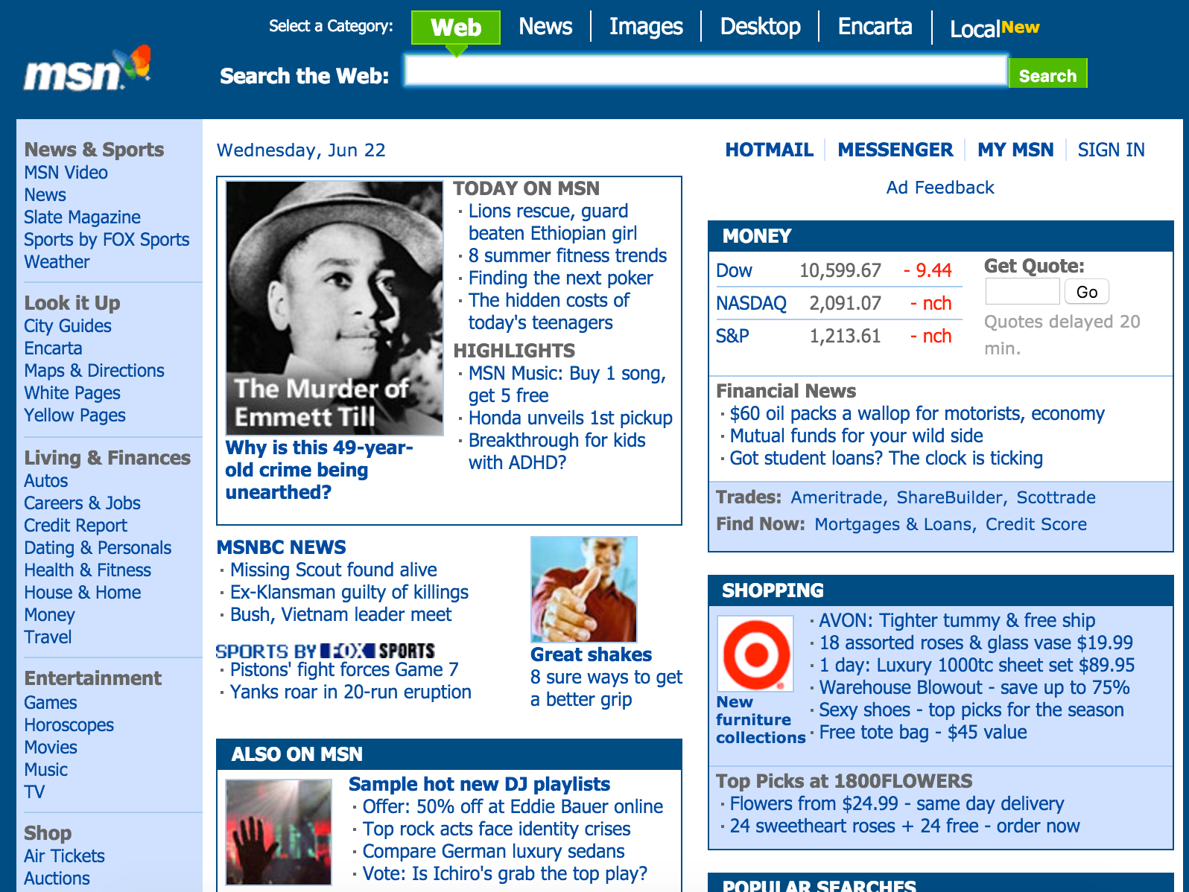
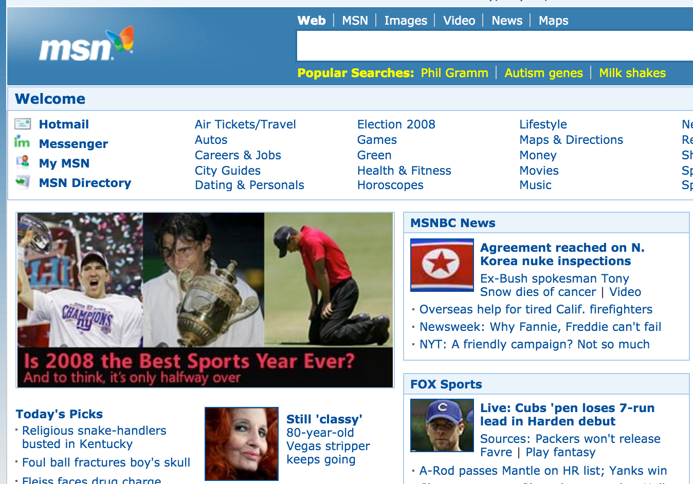
Detail
www.msn.com/news/june
June 22, 2001
BACK
www.msn.com/news/june
June 22, 2005
www.msn.com/news/may
May 22, 2005

Slide 8
Needed Tools
WARCreate
PhantomJS

Slide 9
Group Roles

Slide 10
Estimation

